Slide 1
PayPal Guest Checkout

Slide 2
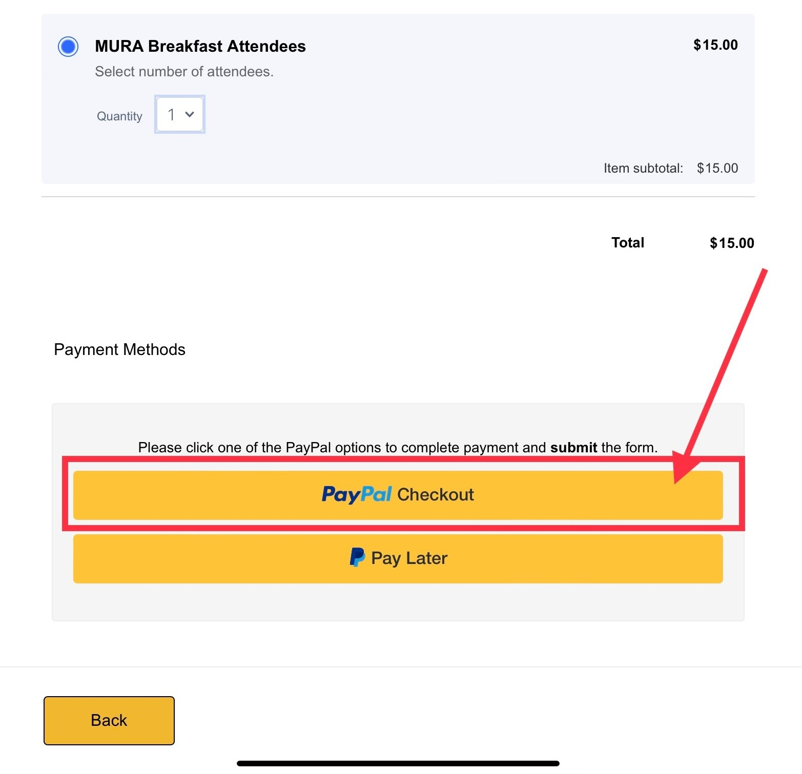

Slide 3
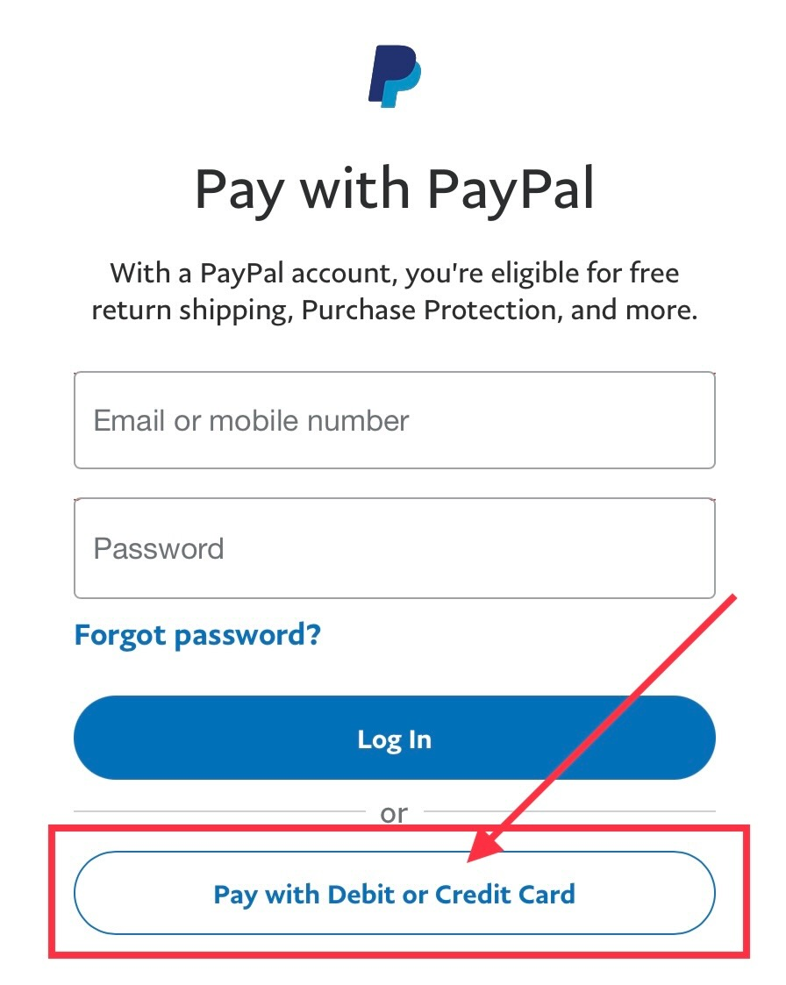

Slide 4
